Slide 1
THE “RASPBERRY” Security system – BY EBONI & ALEX. ALPHA VERSION
https://github.com/AlexRodriguez22/Team-Project.git
The goal: Build a security system using a camera, passive infrared motion sensor, and incorporating a notification system using IFTTT (If This Then That).
GPIO will be used to help us interface the motion sensor with the Raspberry Pi while using a LED to show the user motion is being detected.
Some of the helpful feedback that we received is, we should implement the doorbell (button) last because it is the less invasive to add. Increasing the range of the sensor. With the button we should add a doorbell sound. Try and get the camera to send a pic or notification of the detection. Have the led blink or stay solid until the no intruder detected.
We plan on working on the other components first making sure they are working properly, before adding the doorbell (button). Once we get the other components working fine, then we will add in the button and get working as it should. For the sound we will be playing sound inside tkinter application using playsound library and add a speaker. We plan on going with the blink led to keep blinking until no intruder is detected. Increasing the range will help make it that the object that tripped the sensor does not have to be up close to it but a couple inches away and still detect.

Slide 2
BETA VERSION
We have recently got the button “doorbell” working with a ding dong sound that rings off when the button is pressed. We have also got the LED to stay solid until no intruder is detected.
The feedback that we received today from our peers is that we should implement a picture that sends along with the notification. We also were given the idea that the notification should send a link. Another feedback that we received is that we should see about encasing the breadboard and its components to keep everything neat. We are also going to try and get it that even thought the sensor is tripped that you are still able to ring the doorbell.
Our overall feedback was that our idea was very well liked and that, when we get the camera implemented then that will put the icing on the cake.
We plan on working on a redo implementing the camera since we had a minor set back with that. We will be increasing the range of the sensor, so that it has a wider range that it will trip that the intruder can be detected distance away from the sensor. We will work on the notification so that a video link will be sent the owner's phone showing them a video clip who tripped the sensor or rang the doorbell. We plan to also work on having that even thought the sensor was tripped that the intruder can also ring the doorbell and vice versa. We have thought about encasing the breadboard and its components, but we will see how to encase it towards the end shall time allow because the shape of the breadboard maybe a little difficult.

Slide 3
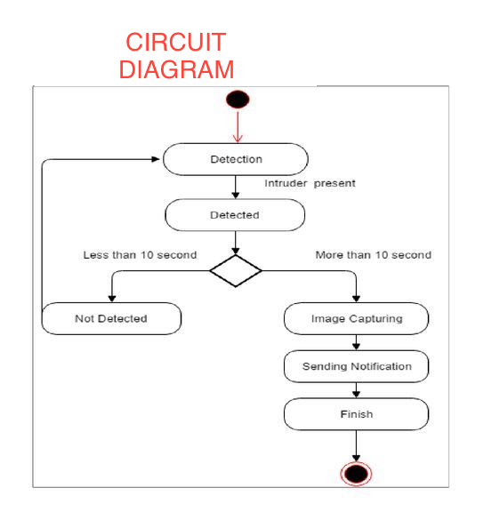

Slide 4
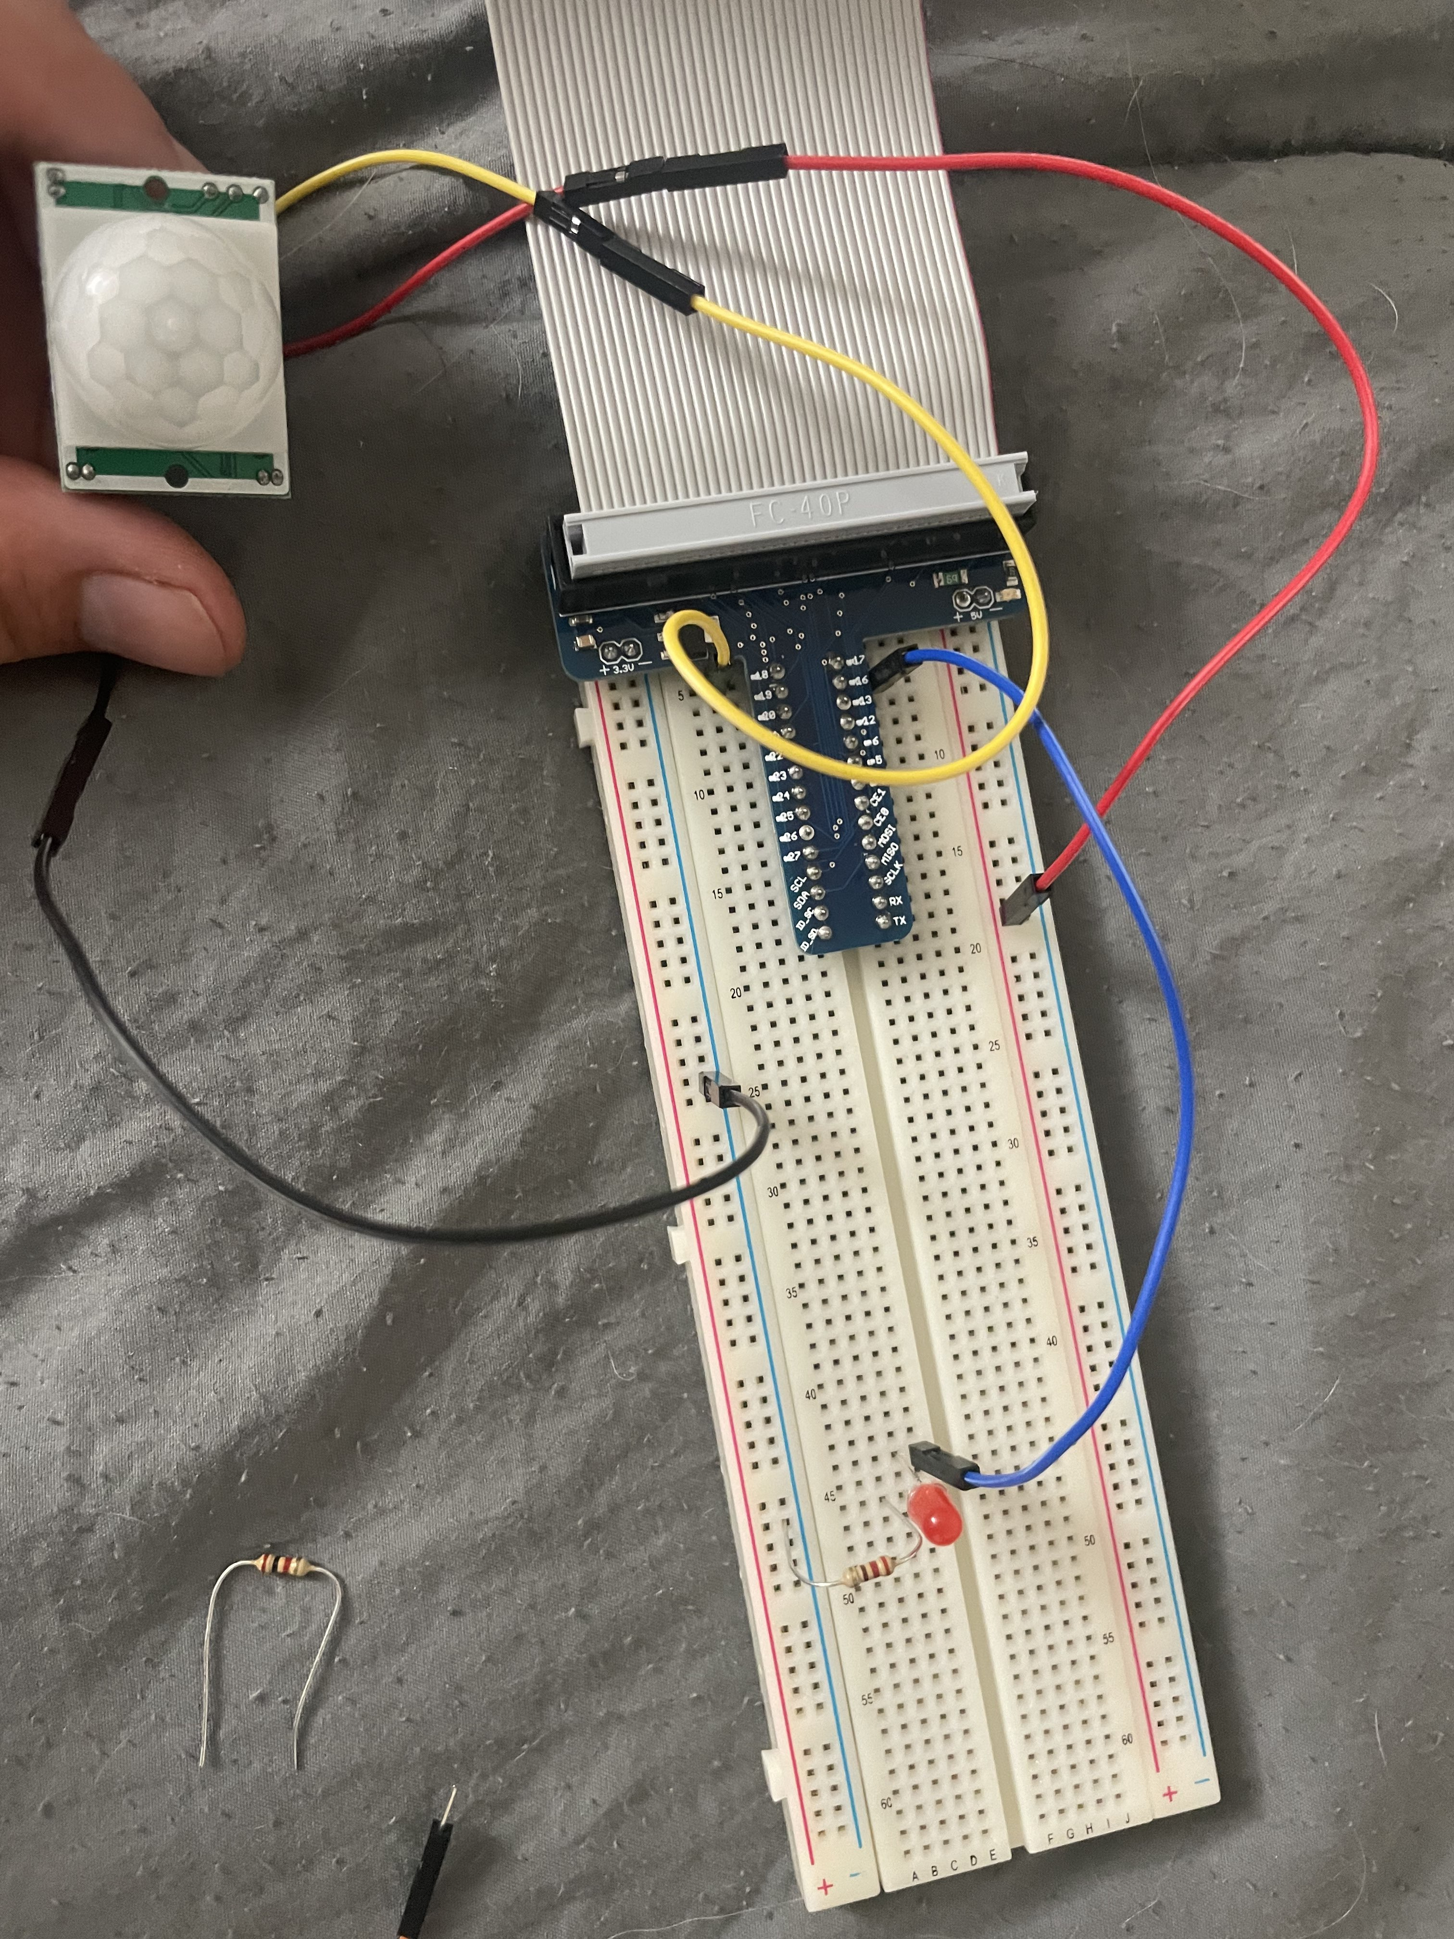
ALPHA LAYOUT

Slide 5
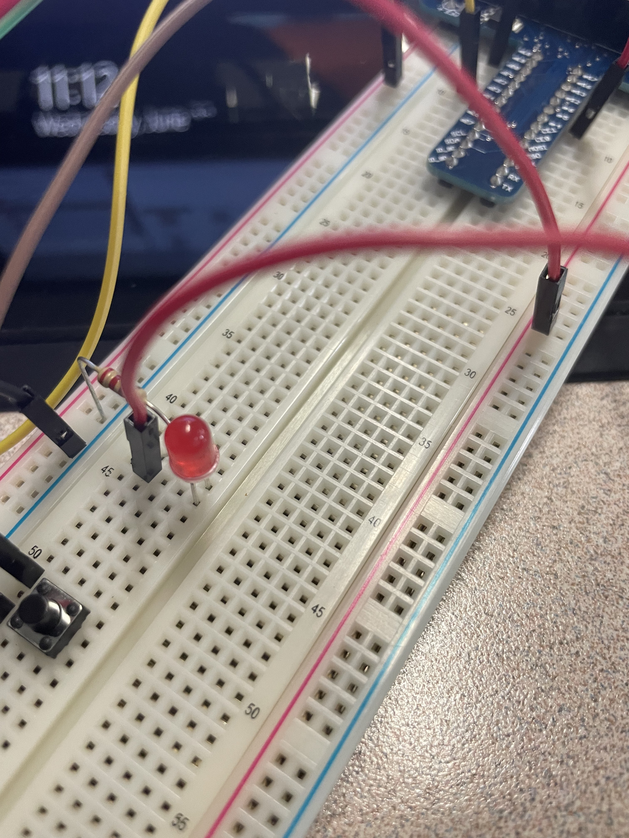
BETA LAYOUT (button “doorbell” was added)

